Slide 1



House P
Senior Design Project
Senior Design Project
House Price Prediction
House Price Prediction Using Ensemble Learning Techniques
Under the guidance of:-
Dr. Manomita Chakraborty
By:-
Raghunath Singh (20BCI7012)
Anuj (20BCE7055)
Under the guidance of:-
Dr. Manomita Chakraborty
By:-
Raghunath Singh (20BCI7012)
Anuj (20BCE7055)
MIRJAM NILSSON​

Slide 2

Agenda
Problem definition
About Dataset
Methodol0gy
Code
Output
summary

Slide 3

Problem definition
To design an Machine Learning Algorithm for the accurate prediction of House Price using Random Forest, Support Vector Regression, Boosting algorithm and Ensemble models.

Slide 4
ABOUT DATASET
The dataset has been taken from Kaggle.
It has following features:-
ID: Unique identifier for each house listing.
Date: Date of the house listing.
Number of bedrooms: The count of bedrooms in the house.
Number of bathrooms: The count of bathrooms in the house.
Living area: Total living area of the house in square feet.
Lot area: Total area of the lot in square feet.
Number of floors: Number of floors in the house.
Waterfront present: Indicates whether the house has a waterfront view (binary: 0 for no, 1 for yes).
Number of schools nearby: Number of schools located near the house.
Distance from the airport: Distance of the house from the nearest airport in miles.
Price: Price of the house.

Slide 5
ABOUT DATASET
Number of views: Number of views the house has received.
Condition of the house: Condition rating of the house.
Grade of the house: Grade rating of the house.
Area of the house (excluding basement): Total area of the house excluding the basement in square feet.
Area of the basement: Area of the basement in square feet.
Built Year: Year the house was originally built.
Renovation Year: Year of the last renovation, if any.
Postal Code: Postal code of the house location.
Latitude: Latitude coordinate of the house location.
Longitude: Longitude coordinate of the house location.
Living area after renovation: Total living area of the house after renovation in square feet.
Lot area after renovation: Total area of the lot after renovation in square feet.
Kaggle Link:- https://www.kaggle.com/datasets/mohamedafsal007/house-price-dataset-of-india

Slide 6
Methodology
Data Exploration:
Loaded the dataset and checked for missing values.
Explored data types and basic statistics.
Visualization:
Plotted count distributions for various features.
Visualized geographical data and price distributions.
Examined correlations and relationships between variables.
Feature Engineering:
Created new features like property age and total square footage
.
Feature Selection:
Identified and removed highly correlated features
.

Slide 7
Methodology
Modeling:
Split data for training and testing.
Trained RandomForest, XGBoost, and CatBoost models.
Evaluated models using R-squared scores.
Combined predictions to create an ensemble model.
Model Selection:
Selected the best-performing model based on R-squared scores.
Deployment:
Saved the selected model for future use.

Slide 8
Code
import pandas as pd
import numpy as np
df=pd.read_csv('House Price India.csv’)
df.head(5)
pd.isnull(df).head()
df.isna().sum()
df.info()
# returns a dataframe with column names of the dataset
pd.DataFrame(list(df.columns), columns=['Column Name’])
from matplotlib import pyplot as plt
import seaborn as sns
# used to return a countplot with null title and figsize to be (15, 8) as default
def countplot(dataframe, x_val, plot_title='', figsize=(15,8)):
plt.figure(figsize=figsize)
plt.title(plot_title)
sns.countplot(data=df, x=x_val)
plt.show()

Slide 9
Code
# used to return a barplot
def barplot(dataframe, x_val, y_val):
sns.barplot(data=dataframe, x=x_val, y=y_val)
plt.title(x_val.title() + ' vs ' + y_val.title())
plt.show()
df.shape
#Univariate Analysis
# returns the countplot of bedrooms
countplot(dataframe=df, x_val='number of bedrooms', plot_title='Count of Number of Bedrooms’)
# returns the countplot of bathrooms
countplot(dataframe=df, x_val='number of bathrooms', plot_title='Count of Number of Bathrooms’)
# returns the countplot of floors
countplot(dataframe=df, x_val='number of floors', figsize=(8,5), plot_title='Count of Number of Floors’)
# returns the countplot of number water present or not
countplot(dataframe=df, x_val='waterfront present', figsize=(8,6), plot_title='Water present (1) or not (0)')

Slide 10
Code
# returns the countplot of views
countplot(dataframe=df, x_val='number of views', figsize=(8,5), plot_title='Number of Views’)
plt.figure(figsize=(10,10))
sns.jointplot(x=df.Lattitude.values, y=df.Longitude.values,size=10)
plt.ylabel('Longitude',fontsize=12)
plt.xlabel('Latitude',fontsize=12)
plt.show()
sns.despine
# returns the countplot of House Condition
countplot(dataframe=df, x_val='condition of the house', figsize=(8,5), plot_title='House Condition’)
# returns the countplot of each grade of house
countplot(dataframe=df, x_val='grade of the house', figsize=(8,5), plot_title='Grade of the House’)
# returns the countplot of Scools nearby
countplot(dataframe=df, x_val='Number of schools nearby', figsize=(8,5), plot_title='Number of Schools Nearby’)
sns.displot(df['Price'])
plt.title('Price Distribution')
plt.show()

Slide 11
Code
# Visualize correlation matrix using a heatmap
correlation_matrix = df.corr()
plt.figure(figsize=(12, 8))
sns.heatmap(correlation_matrix, annot=True, cmap='coolwarm', fmt=".2f")
# plt.title('Correlation Matrix')
plt.suptitle('Correlation Matrix', y=1.02)
plt.tight_layout()
plt.show()
# Pairplot to visualize relationships between numerical variables
sns.pairplot(df[['number of bedrooms', 'living area', 'lot area', 'number of floors', 'Price']])
plt.suptitle('Pairplot of Numerical Variables', y=1.02) # Adjust the y-coordinate to prevent overlapping
plt.tight_layout() # Automatically adjusts subplot parameters for better layout
plt.show()
# Boxplot to identify patterns and outliers
plt.figure(figsize=(15, 8))
sns.boxplot(x='number of bedrooms', y='Price', data=df)
plt.title('Boxplot of Price by Number of Bedrooms')
plt.show()

Slide 12
Code
from datetime import datetime
# from math import radians, sin, cos, sqrt, atan2
# Current year
current_year = datetime.now().year
# Age of Property
df['age_of_property'] = current_year - df['Built Year']
# Total Square Footage
df['total_sqft'] = df['living area'] + df['lot area']
# Renovation Age
# Calculate age of renovation, substituting Built Year if Renovation Year is 0
df['age_of_renovation'] = current_year - df.apply(lambda row: row['Renovation Year'] if row['Renovation Year'] != 0 else row['Built Year'], axis=1)
# Quality of Location
df['quality_of_location'] = df['grade of the house'] + df['waterfront present']
# Basement Ratio
df['basement_ratio'] = df['Area of the basement'] / df['Area of the house(excluding basement)']
# Floor Area Ratio
df['floor_area_ratio'] = df['living area'] / df['lot area']
# Display the updated DataFrame
print(df.head())

Slide 13
Code
correlation_matrix = df.corr()
plt.figure(figsize=(24, 18)) # Adjusted figure size
sns.heatmap(correlation_matrix, annot=True, cmap='coolwarm', fmt=".2f")
plt.suptitle('Correlation Matrix', y=0.95) # Adjusted y position of the title
plt.tight_layout() # Adjust layout to prevent overlapping
plt.show()
# Convert 'number of bathrooms' and 'number of floors' to integers
df['number of bathrooms'] = df['number of bathrooms'].astype(int)
df['number of floors'] = df['number of floors'].astype(int)
df['floor_area_ratio']=df['floor_area_ratio'].astype(int)
df['basement_ratio']=df['basement_ratio'].astype(int)
df['age_of_renovation']=df['age_of_renovation'].astype(int)
df.info()

Slide 14
Code
# Calculate the correlation matrix
correlation_matrix = df[['number of bedrooms', 'number of bathrooms', 'living area', 'lot area',
'number of floors', 'waterfront present', 'number of views',
'condition of the house', 'grade of the house',
'Area of the house(excluding basement)', 'Area of the basement',
'Built Year', 'Renovation Year', 'Postal Code', 'Lattitude', 'Longitude',
'living_area_renov', 'lot_area_renov', 'Number of schools nearby',
'Distance from the airport', 'age_of_property', 'total_sqft',
'age_of_renovation', 'quality_of_location', 'basement_ratio',
'floor_area_ratio', 'Price']].corr()
# Display the correlation matrix
print(correlation_matrix)
# Filter the correlation values with respect to the target variable (Price)
price_correlation = correlation_matrix['Price'].sort_values(ascending=False)
# Display the correlation values
print(price_correlation)

Slide 15
Code
df = df.drop(columns=['id', 'Date'])
# Print the first few rows to verify the changes
print(df.head())
df.head()
#redunant attribute checking on full dataset column for removing unnecessary columns.
import seaborn as sns
import matplotlib.pyplot as plt
# Compute the correlation matrix for the entire dataset
correlation_matrix = df.corr()
# Set the size of the figure
plt.figure(figsize=(28, 36))
# Create the heatmap with annotations and a colormap
sns.heatmap(correlation_matrix, annot=True, cmap=plt.cm.CMRmap_r)
# Show the plot
plt.show()

Slide 16
Code
def correlation(dataset, threshold):
col_corr = set()
corr_matrix = dataset.corr()
for i in range(len(corr_matrix.columns)):
for j in range(i):
if corr_matrix.iloc[i, j] > threshold:
# if corr_matrix.iloc[i, j] > threshold or corr_matrix.iloc[i, j] < -threshold:
colname = corr_matrix.columns[i]
col_corr.add(colname)
return col_corr
corr_features=correlation(df,0.7)
len(set(corr_features))
corr_features
corr_features.discard('Price')
corr_features
# Drop the correlated features from the DataFrame
df = df.drop(corr_features,axis=1)
# Save the modified DataFrame to a new CSV file
df.to_csv("modified_dataset.csv", index=False)

Slide 17
Code
# Load the modified CSV file into a DataFrame
modified_df = pd.read_csv("modified_dataset.csv")
# Display the head of the modified DataFrame
modified_df.head()
modified_df = modified_df.drop(columns=['Lattitude', 'Longitude','Postal Code'])
# Save the modified DataFrame to a new CSV file
modified_df.to_csv("modified_dataset.csv", index=False)
modified_df.head()
# Separate features (X) and target variable (y)
X = modified_df.drop('Price', axis=1)
y = modified_df['Price’]
modified_df = modified_df.drop(columns=['Built Year','Renovation Year','basement_ratio','Distance from the airport','Number of schools nearby','floor_area_ratio','condition of the house','Area of the basement'])
# Save the modified DataFrame to a new CSV file
modified_df.to_csv("modified_dataset.csv", index=False)
modified_df.head()

Slide 18
Code
from sklearn.model_selection import train_test_split
# Split the data into train and test sets
X_train, X_test, y_train, y_test = train_test_split(X, y, test_size=0.2, random_state=42)
from sklearn.preprocessing import StandardScaler
# Initialize the scaler for feature
scaler = StandardScaler()
# Fit the scaler to the training data and transform the training data
X_train_scaled = scaler.fit_transform(X_train)
# Transform the testing data using the scaler fitted on the training data
X_test_scaled = scaler.transform(X_test)
# Initialize the scaler for the target variable
target_scaler = StandardScaler()
# Fit and transform the training target variable
y_train_scaled = target_scaler.fit_transform(y_train.values.reshape(-1, 1)).flatten()
# Transform the testing target variable
y_test_scaled = target_scaler.transform(y_test.values.reshape(-1, 1)).flatten()

Slide 19
Code
from sklearn.ensemble import RandomForestRegressor, GradientBoostingRegressor, VotingRegressor
from sklearn.svm import SVR
from sklearn.linear_model import LinearRegression
from xgboost import XGBRegressor
from sklearn.metrics import mean_squared_error, mean_absolute_error, r2_score
from sklearn.model_selection import GridSearchCV
from sklearn.model_selection import train_test_split
from sklearn.ensemble import RandomForestRegressor
from xgboost import XGBRegressor
from sklearn.model_selection import train_test_split
from sklearn.metrics import mean_squared_error, mean_absolute_error, r2_score
# Define individual base models
random_forest_model = RandomForestRegressor()
xgboost_model = XGBRegressor()
# Train individual base models
random_forest_model.fit(X_train_scaled, y_train)
xgboost_model.fit(X_train_scaled, y_train)

Slide 20
Code
# Make predictions using individual base models
y_pred_rf = random_forest_model.predict(X_test_scaled)
y_pred_xgb = xgboost_model.predict(X_test_scaled)
y_pred_rf
y_pred_xgb
# Evaluate Random Forest model
r2_rf = r2_score(y_test, y_pred_rf)
# Evaluate XGBoost model
r2_xgb = r2_score(y_test, y_pred_xgb)
print("Random Forest Model:")
print("R-squared:", r2_rf)
print("\nXGBoost Model:")
print("R-squared:", r2_xgb)
# Combine predictions using averaging
ensemble_predictions = (y_pred_rf + y_pred_xgb) / 2
# Evaluate ensemble model
r2 = r2_score(y_test, ensemble_predictions)
print("R-squared:", r2)

Slide 21
Code
# !pip install catboost
from sklearn.ensemble import RandomForestRegressor
from xgboost import XGBRegressor
from catboost import CatBoostRegressor
from sklearn.model_selection import train_test_split
from sklearn.metrics import mean_squared_error, mean_absolute_error, r2_score
# Define individual base models
# random_forest_model = RandomForestRegressor()
xgboost_model = XGBRegressor()
catboost_model = CatBoostRegressor(verbose=0)
# Train individual base models
random_forest_model.fit(X_train, y_train)
xgboost_model.fit(X_train, y_train)
catboost_model.fit(X_train, y_train)

Slide 22
Code
# Make predictions using individual base models
y_pred_rf = random_forest_model.predict(X_test)
y_pred_xgb = xgboost_model.predict(X_test)
y_pred_cb = catboost_model.predict(X_test)
r_cb=r2_score(y_test,y_pred_cb)
print("catboost:")
print("R-Squared: ",r_cb)
# Combine predictions using averaging
ensemble_predictions = (y_pred_rf + y_pred_xgb + y_pred_cb) / 3
# Evaluate ensemble model
r2 = r2_score(y_test, ensemble_predictions)
print("Ensemble Model:")
print("R-squared:", r2)

Slide 23
Code
from sklearn.ensemble import RandomForestRegressor
from xgboost import XGBRegressor
from catboost import CatBoostRegressor
from sklearn.model_selection import train_test_split
from sklearn.metrics import mean_squared_error, mean_absolute_error, r2_score
# Define individual base models
random_forest_model = RandomForestRegressor()
xgboost_model = XGBRegressor()
catboost_model = CatBoostRegressor(verbose=0)
# Train individual base models
random_forest_model.fit(X_train_scaled, y_train)
xgboost_model.fit(X_train_scaled, y_train)
catboost_model.fit(X_train_scaled, y_train)
# Make predictions using individual base models
y_pred_rf = random_forest_model.predict(X_test_scaled)
y_pred_xgb = xgboost_model.predict(X_test_scaled)
y_pred_cb = catboost_model.predict(X_test_scaled)
r2_xg=r2_score(y_test,y_pred_xgb)
print("xgboost Model:")
print("R-squared:", r2_xg)

Slide 24
Code
# Combine predictions using averaging
ensemble_predictions = (y_pred_rf + y_pred_xgb + y_pred_cb) / 3
# Evaluate ensemble model
r2 = r2_score(y_test, ensemble_predictions)
print("Ensemble Model:")
print("R-squared:", r2)
# Define a threshold (e.g., mean of the target variable)
threshold = y_train.mean()
# Classify predictions
predicted_classes = (ensemble_predictions > threshold).astype(int)
actual_classes = (y_test > threshold).astype(int)
# Calculate True Positives, False Positives, False Negatives
true_positives = ((predicted_classes == 1) & (actual_classes == 1)).sum()
false_positives = ((predicted_classes == 1) & (actual_classes == 0)).sum()
false_negatives = ((predicted_classes == 0) & (actual_classes == 1)).sum()
# Calculate precision and recall
precision = true_positives / (true_positives + false_positives)
recall = true_positives / (true_positives + false_negatives)
print("Precision:", precision)
print("Recall:", recall)

Slide 25
Code
import pickle
from sklearn.ensemble import RandomForestRegressor, GradientBoostingRegressor, VotingRegressor
from sklearn.svm import SVR
from sklearn.linear_model import LinearRegression
from xgboost import XGBRegressor
from sklearn.metrics import r2_score
from sklearn.model_selection import train_test_split
# Define individual base models
models = {
'Random Forest': RandomForestRegressor(),
'XGBoost': XGBRegressor(),
'CatBoost': CatBoostRegressor(verbose=0)
}
# Train individual base models and compute R-squared scores
r2_scores = {}
for model_name, model in models.items():
model.fit(X_train, y_train)
y_pred = model.predict(X_test)
print("R-squared:", r2_scores[best_model_name])

Slide 26
Code
print("R-squared:", r2_scores[best_model_name])
r2_scores[model_name] = r2_score(y_test, y_pred)
# Evaluate ensemble model and compute its R-squared score
y_pred_rf = random_forest_model.predict(X_test)
y_pred_xgb = xgboost_model.predict(X_test)
y_pred_cb = catboost_model.predict(X_test)
ensemble_predictions = (y_pred_rf + y_pred_xgb + y_pred_cb) / 3
ensemble_r2 = r2_score(y_test, ensemble_predictions)
r2_scores['Ensemble'] = ensemble_r2
# Select the model with the highest R-squared score
best_model_name = max(r2_scores, key=r2_scores.get)
# If the best model is the ensemble, we need to define it separately
if best_model_name == 'Ensemble':
best_model = None # Or you can define your ensemble model here
else:
best_model = models[best_model_name]

Slide 27
Code
# The Ensemble model is the bagging of random_forest+xGradientBoosting+Catboost Algorithm
print("Best Model:", best_model_name)
# Save the selected model as a pickle file
with open('best_model.pkl', 'wb') as f:
pickle.dump(best_model, f)

Slide 28
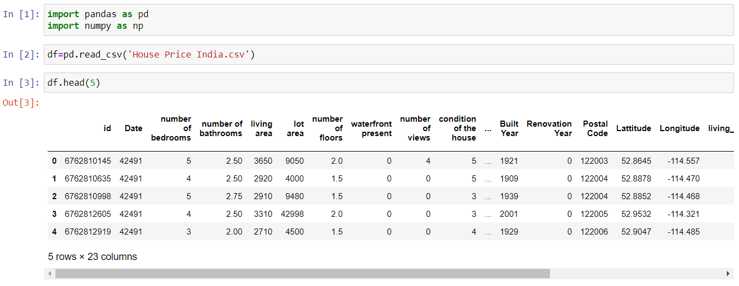
Output

Slide 29
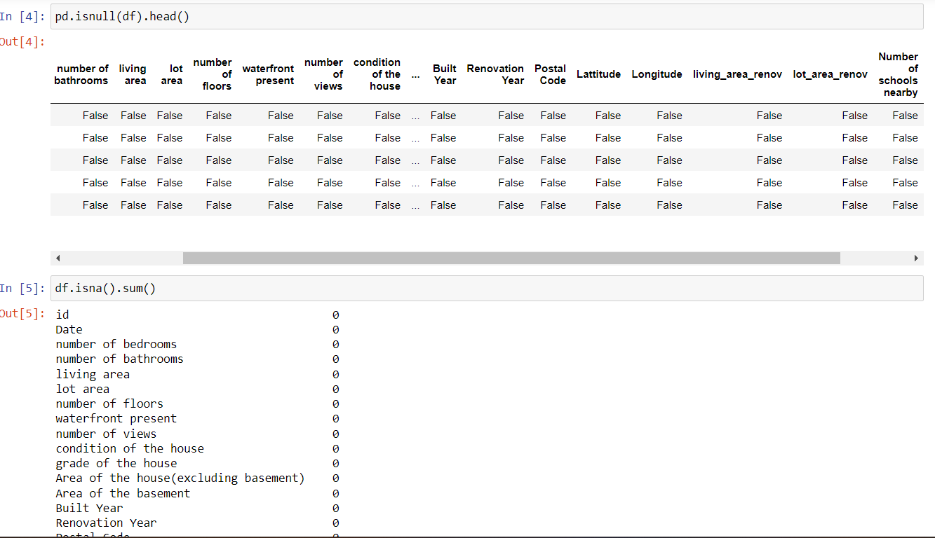

Slide 30
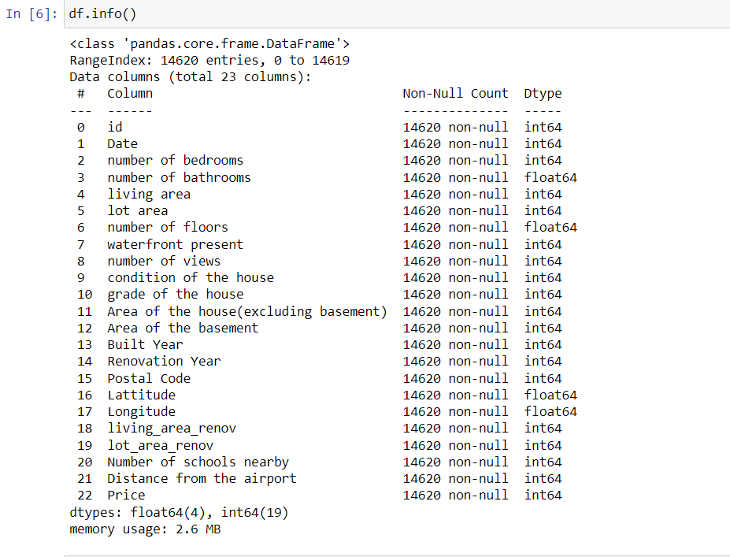

Slide 31
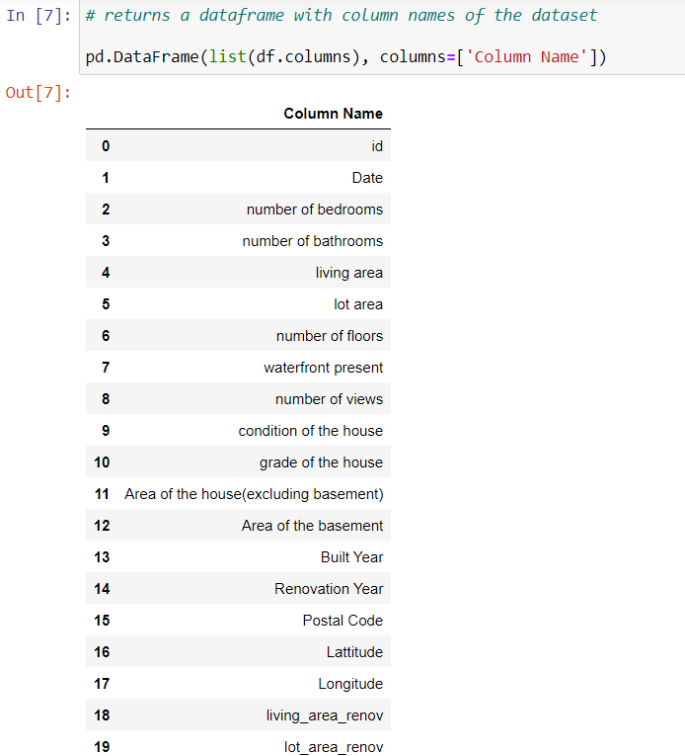

Slide 32
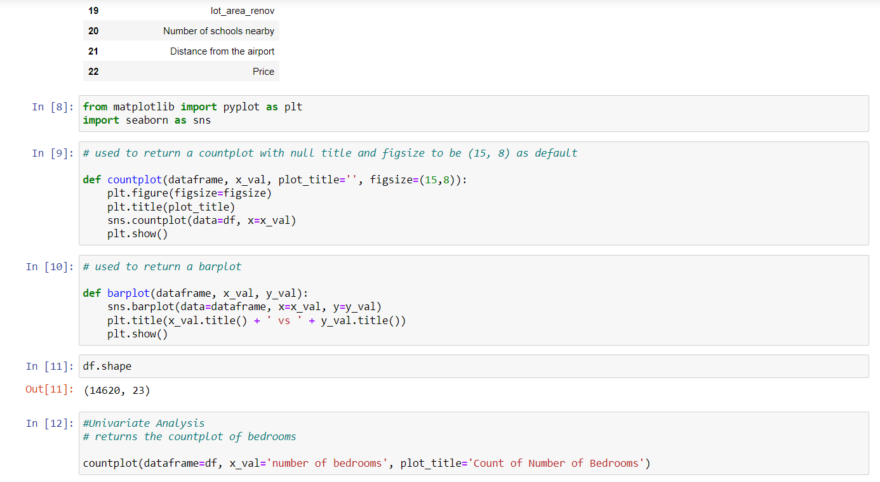

Slide 33
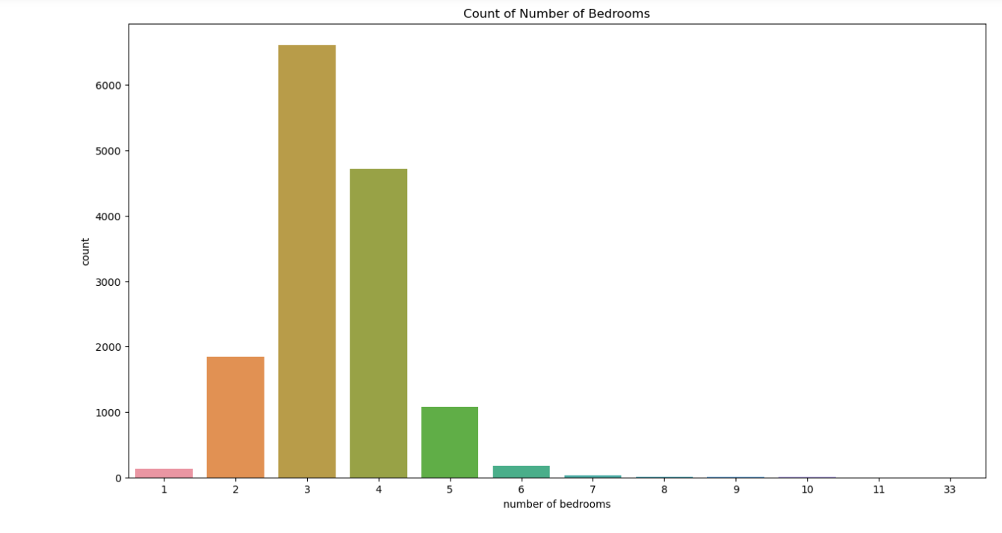
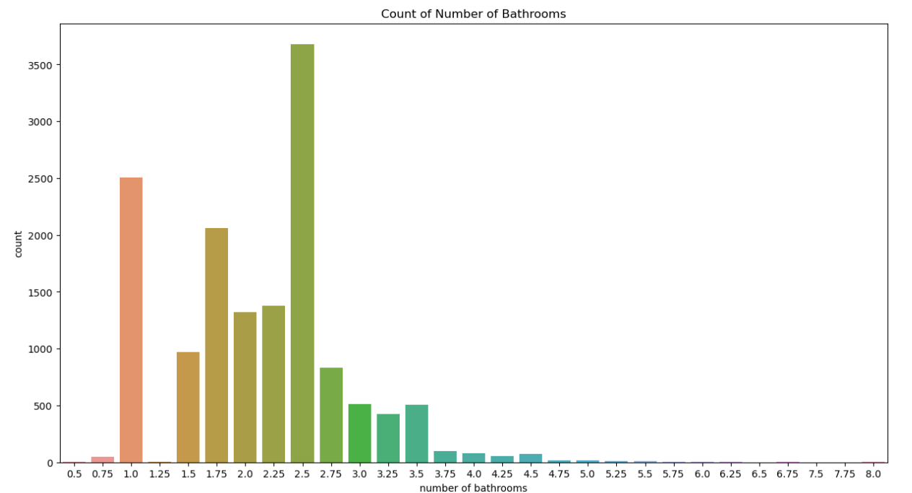

Slide 34
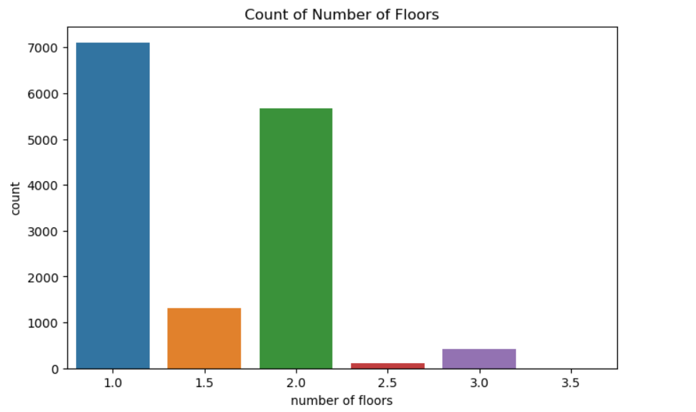

Slide 35
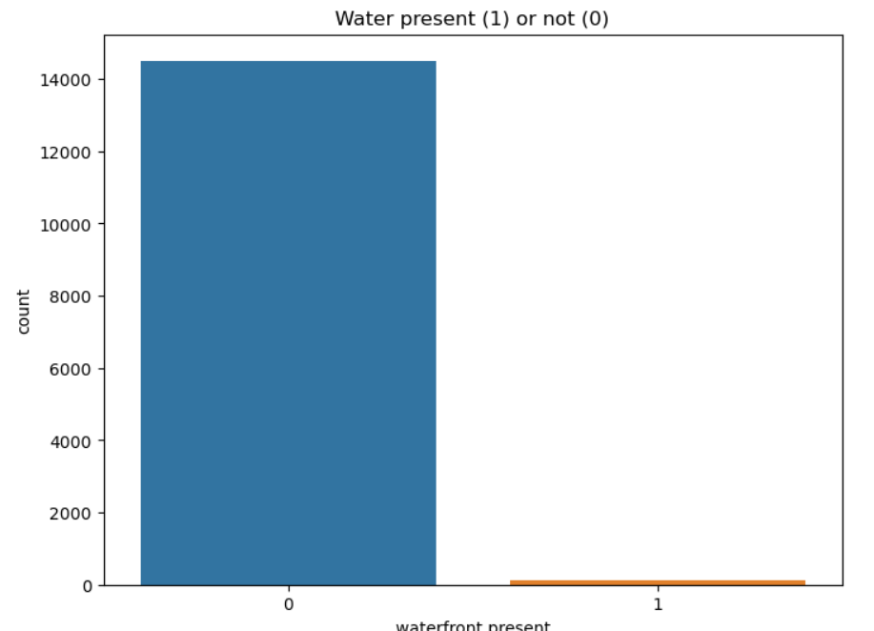
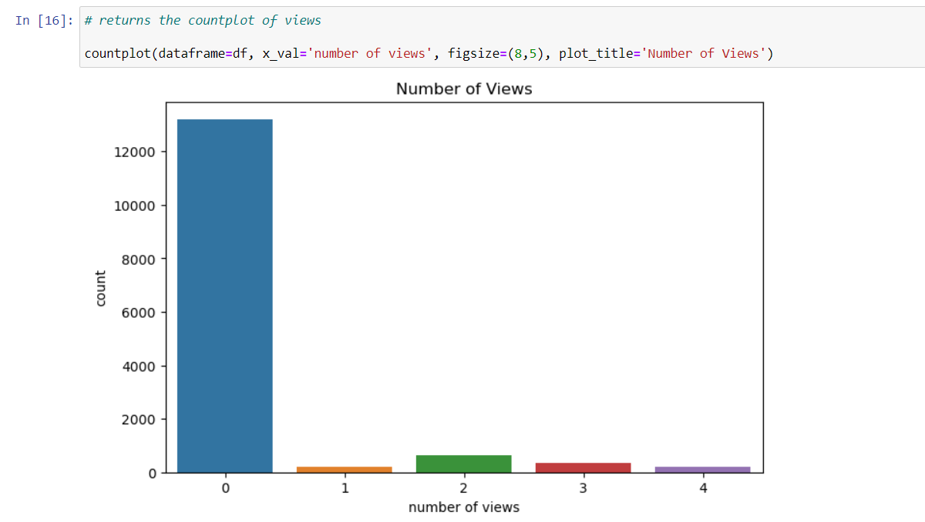

Slide 36
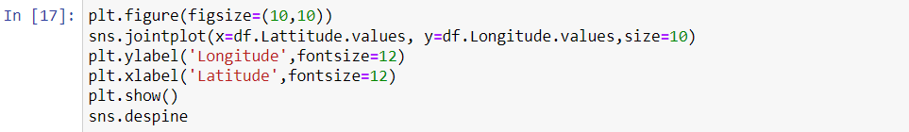
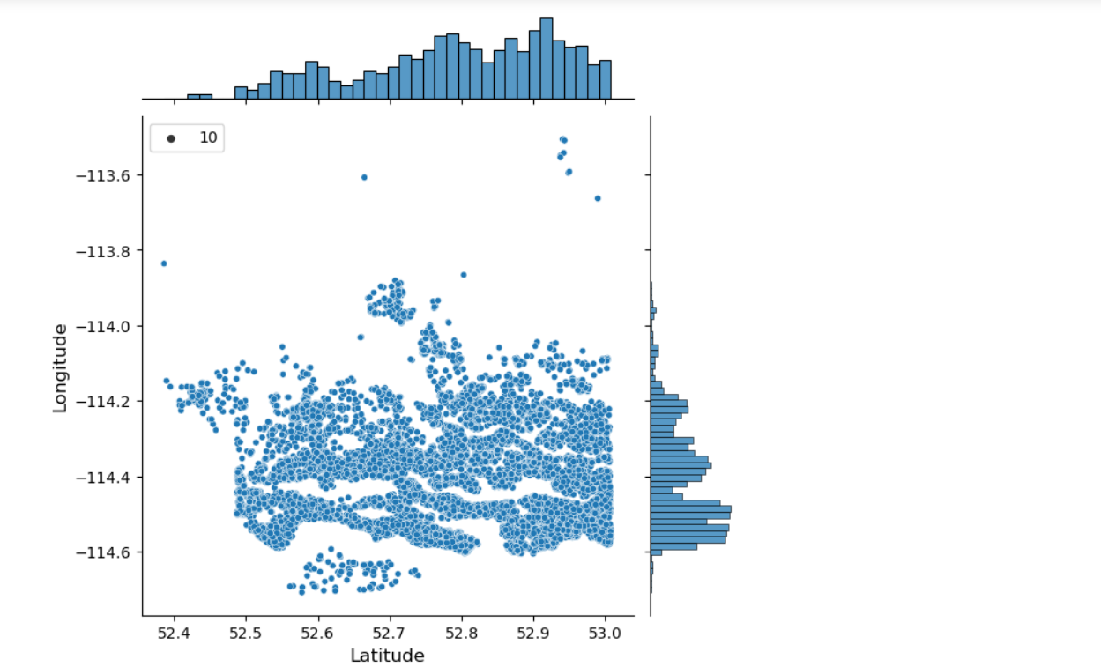
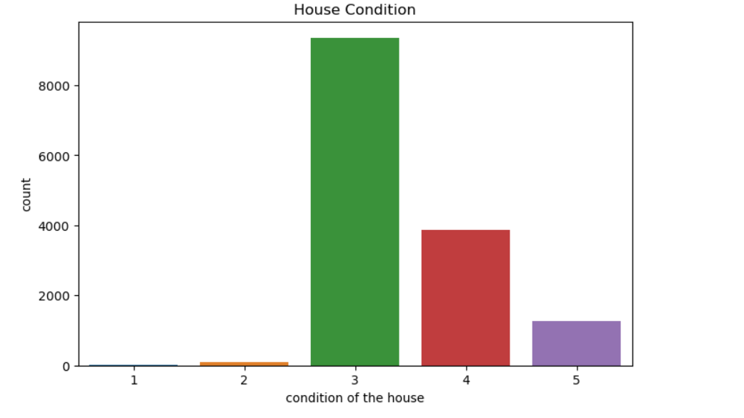

Slide 37
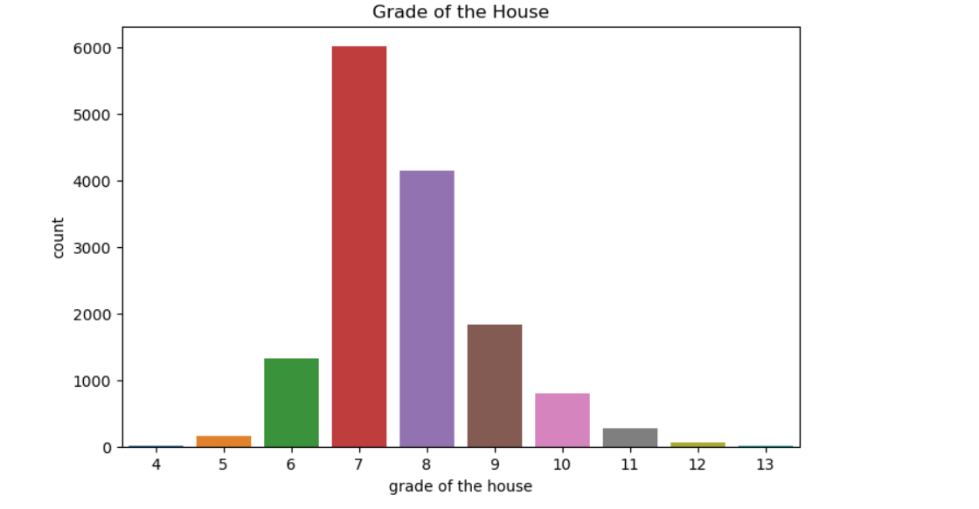
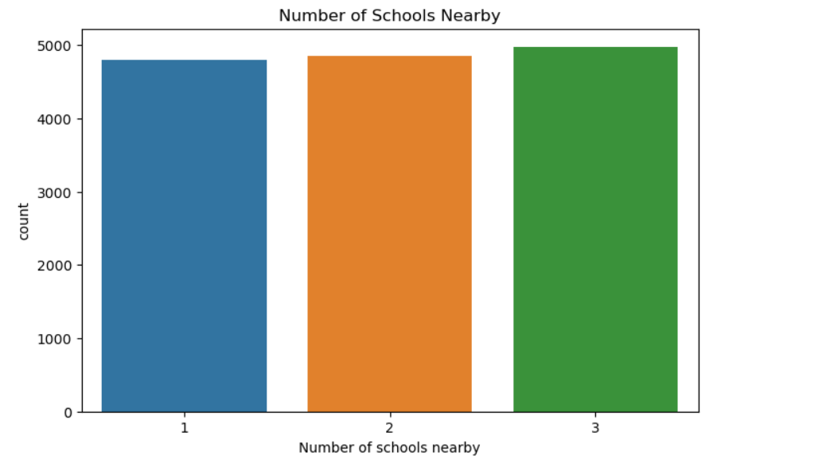

Slide 38
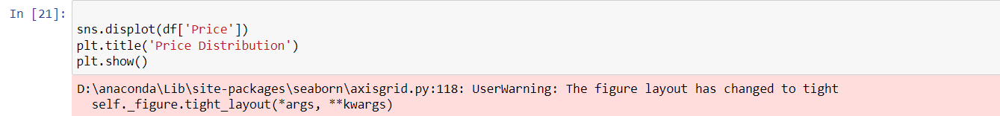
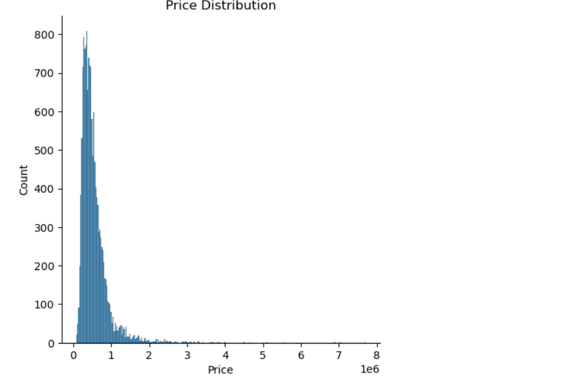
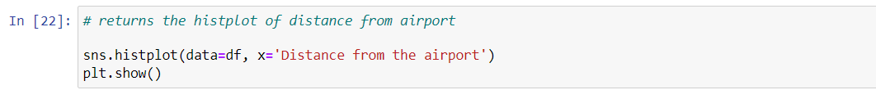
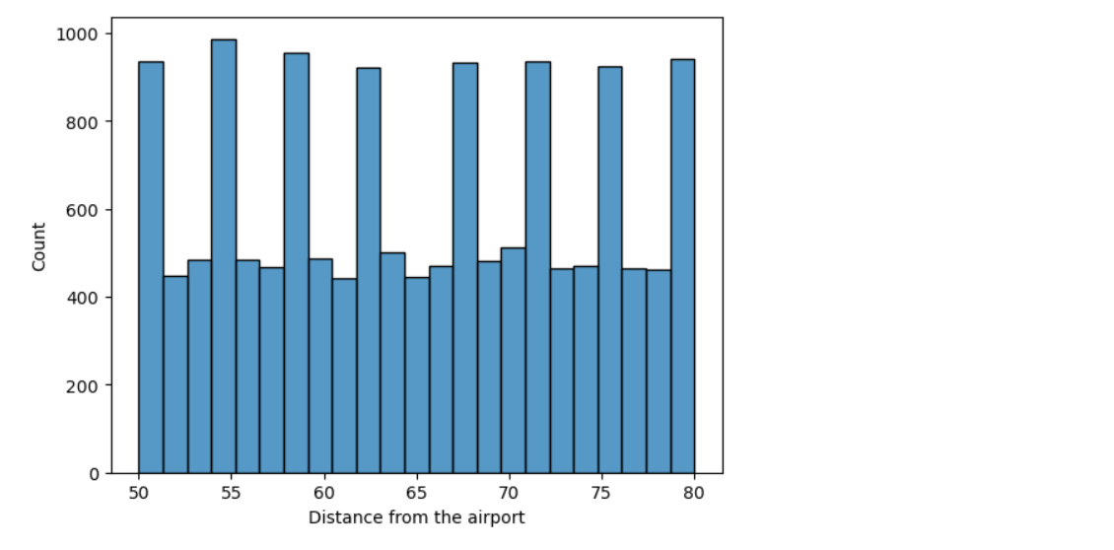

Slide 39
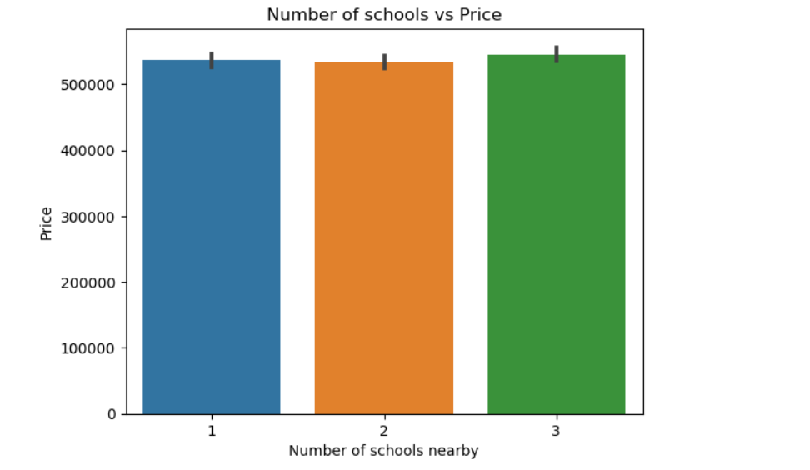
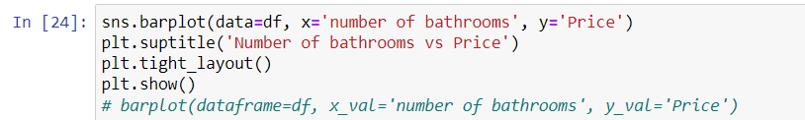
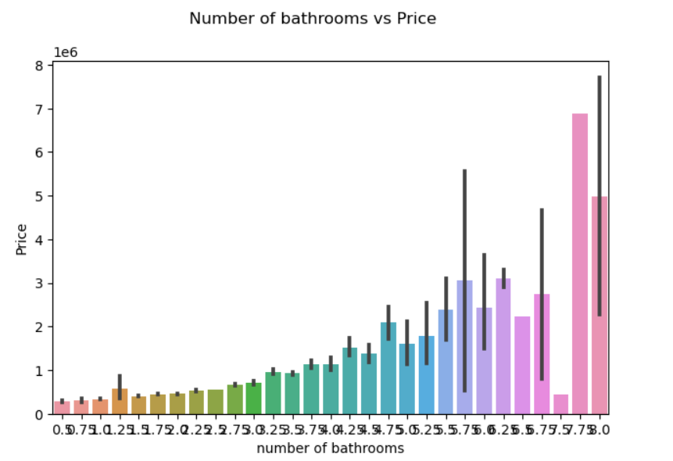

Slide 40
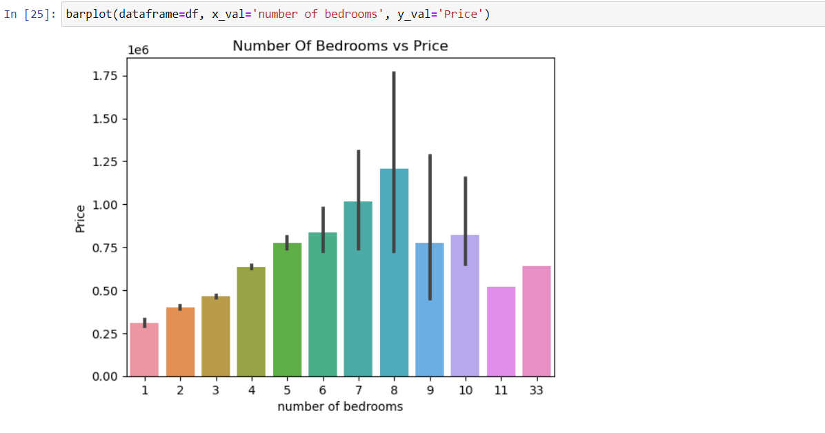
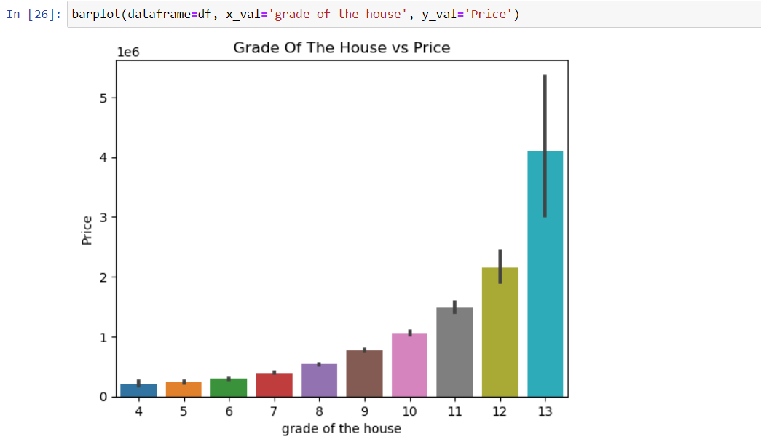
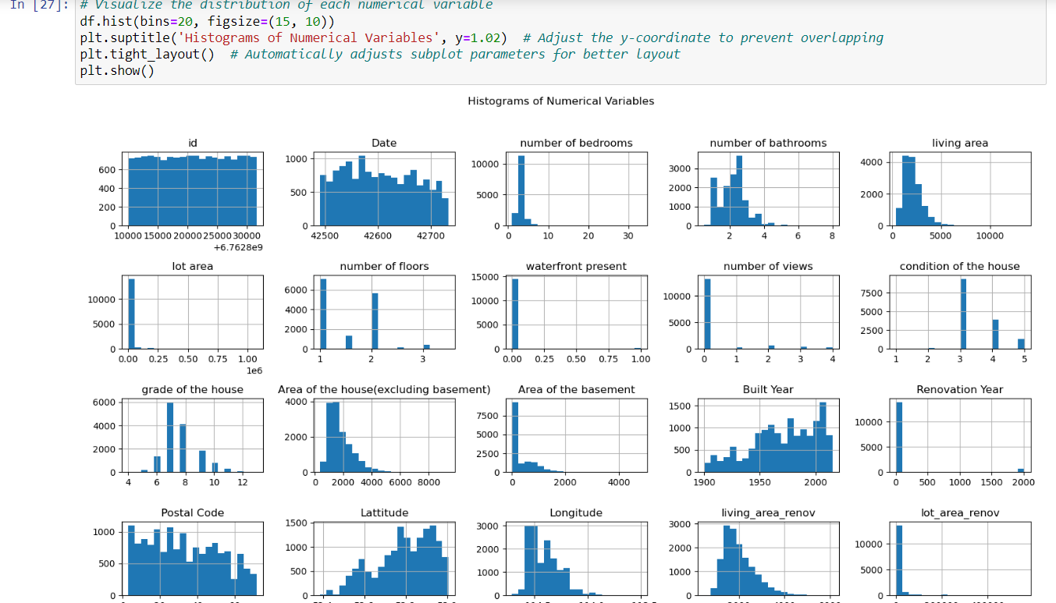
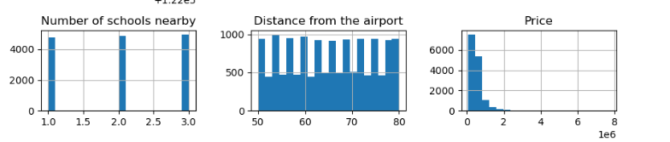

Slide 41
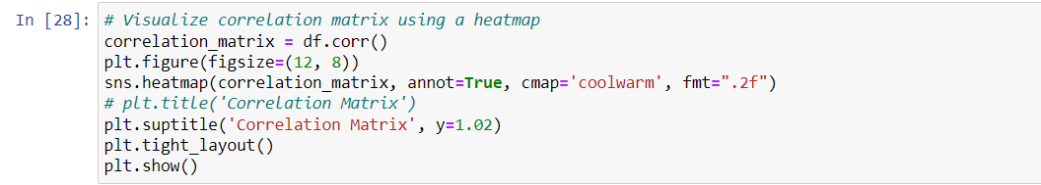
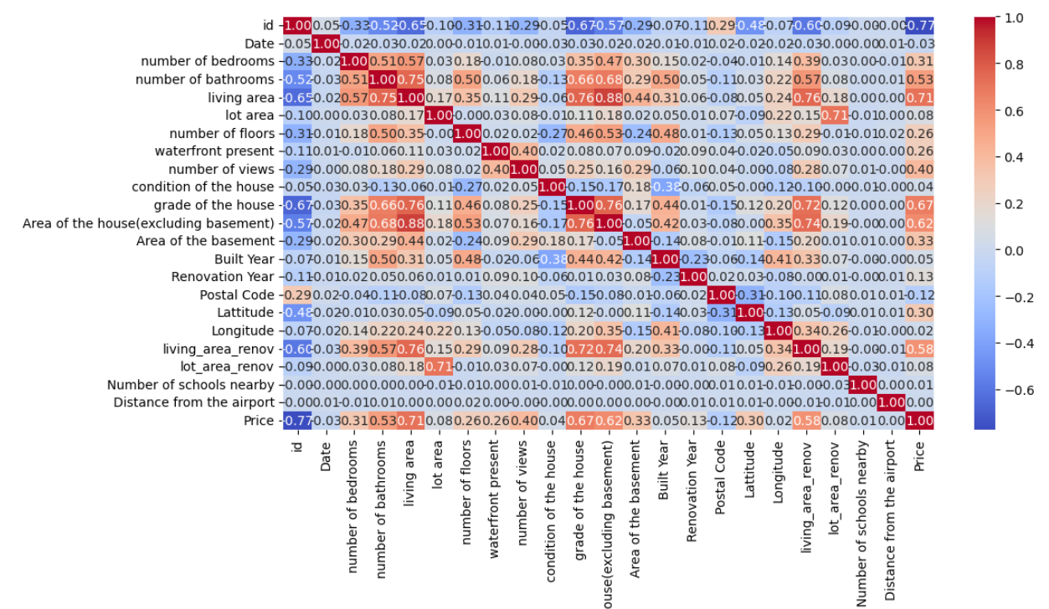
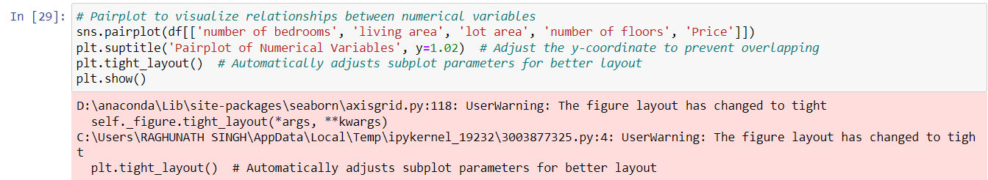

Slide 42
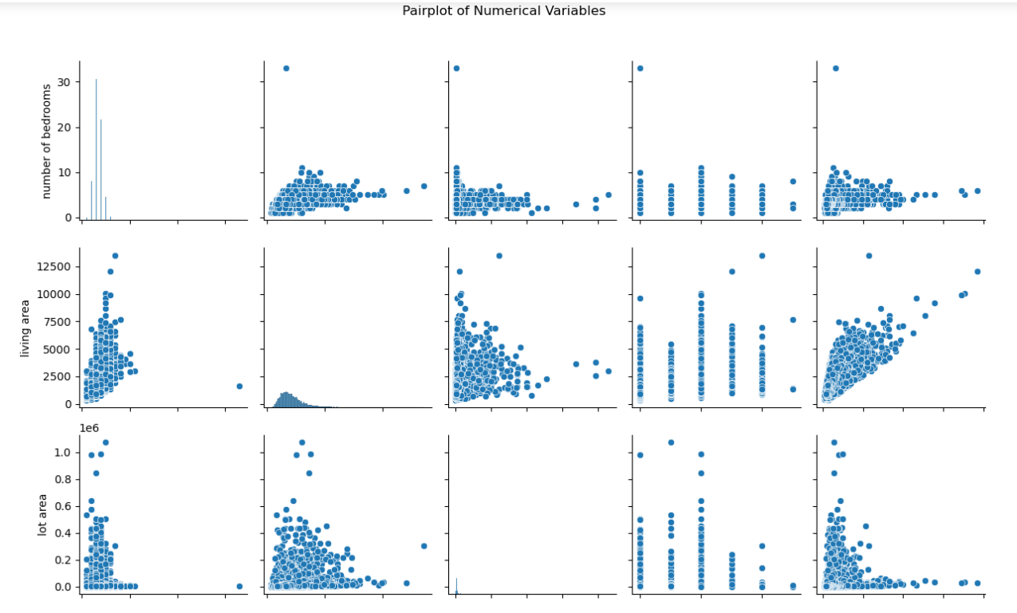
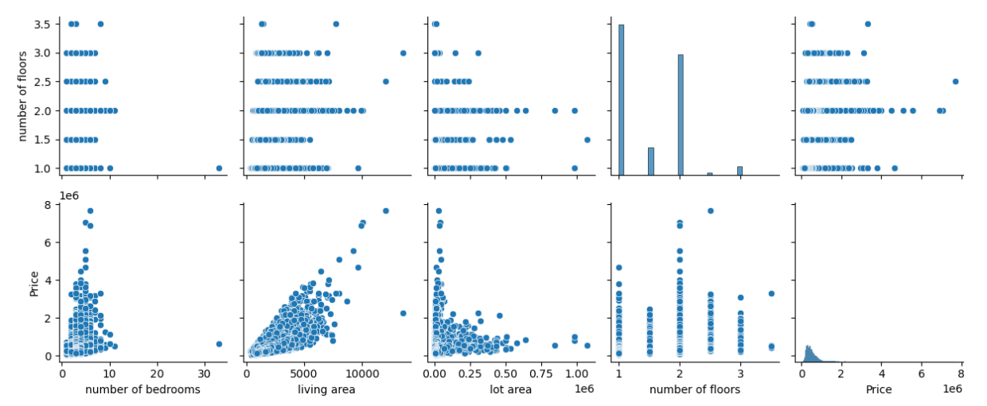

Slide 43
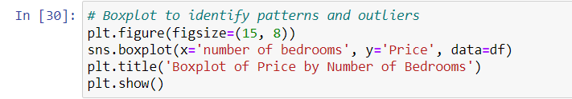
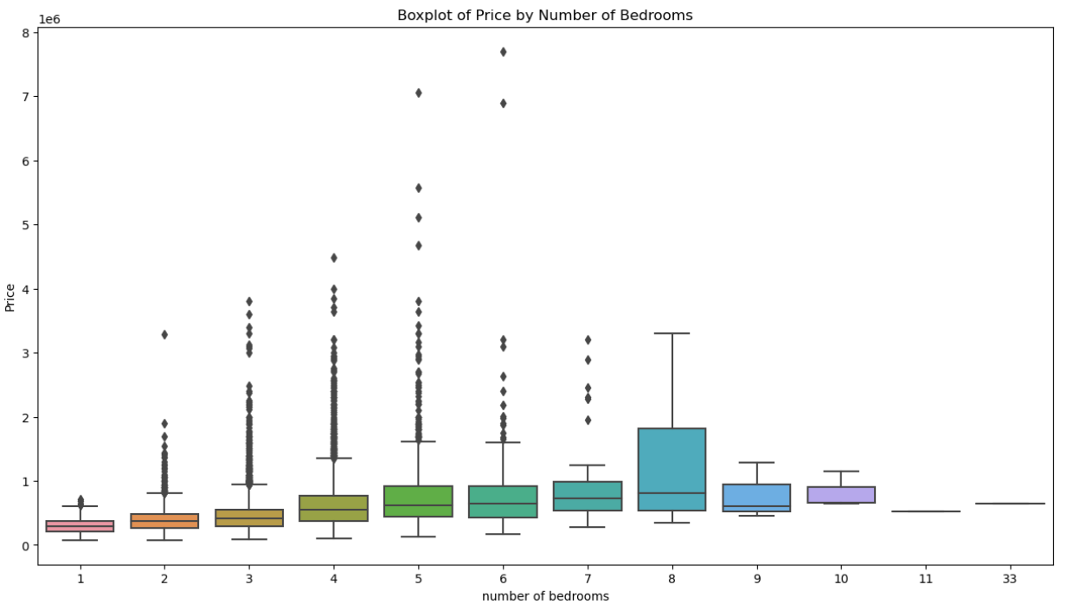

Slide 44
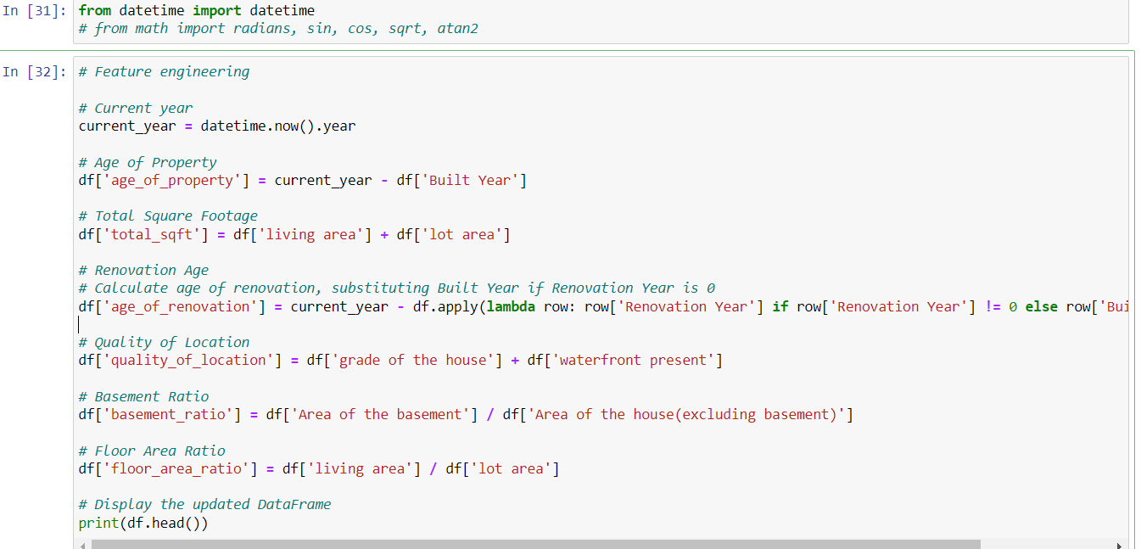
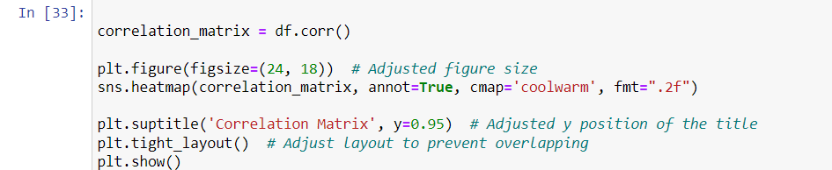

Slide 45
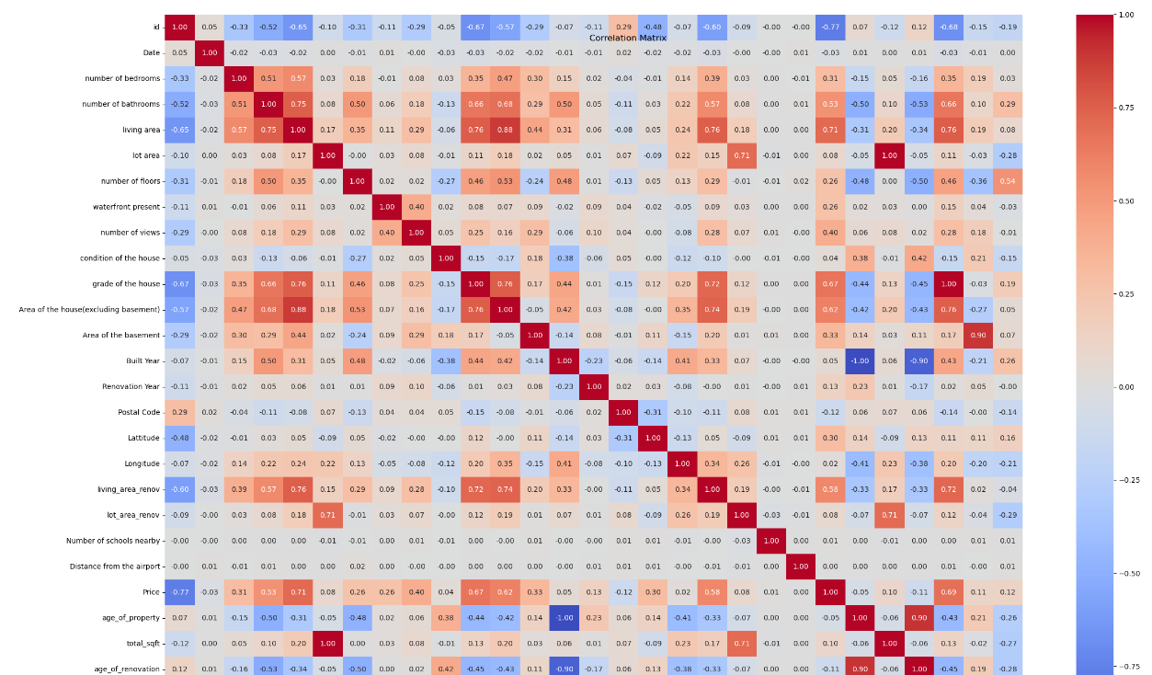
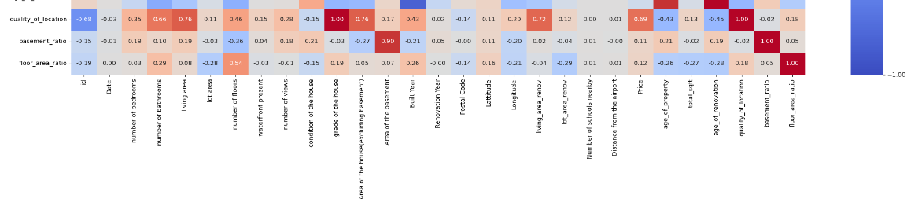
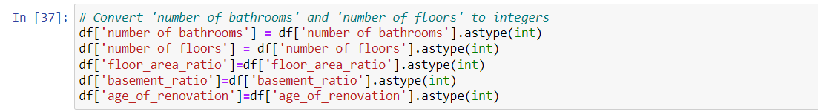

Slide 46
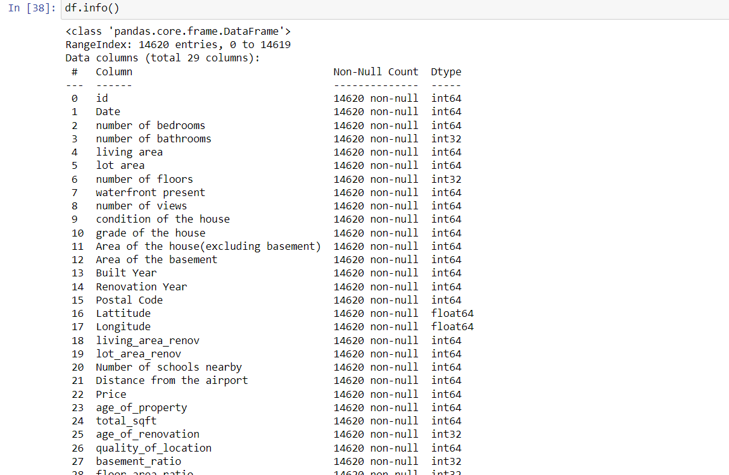
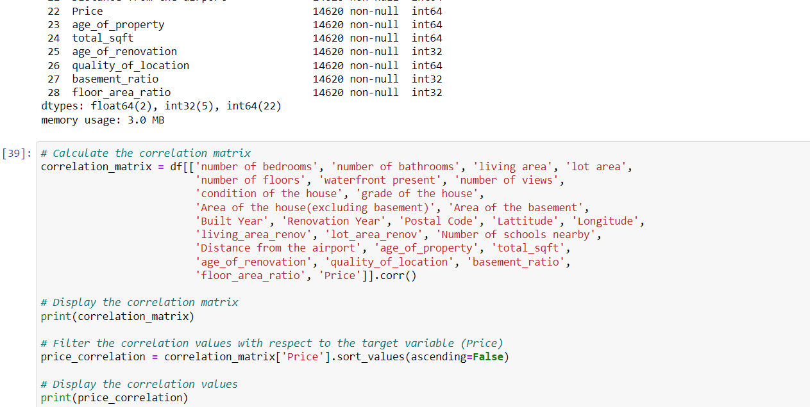

Slide 47
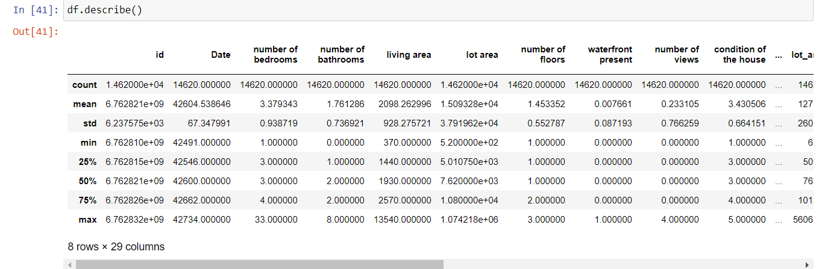
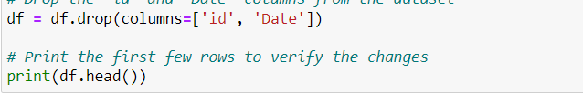
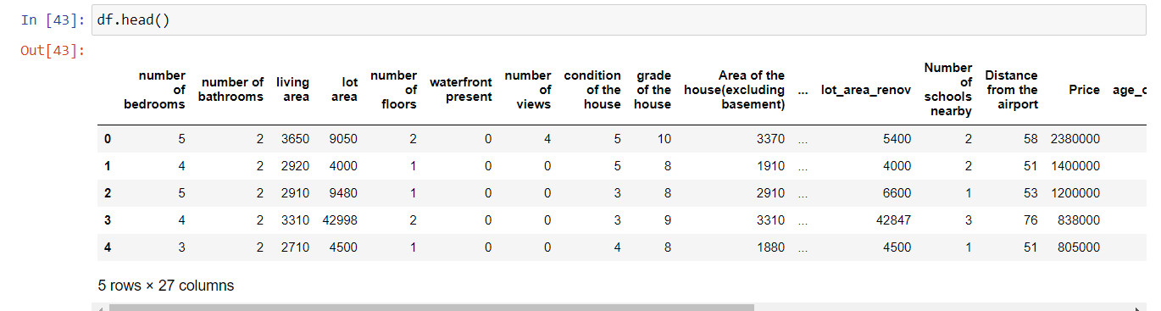

Slide 48
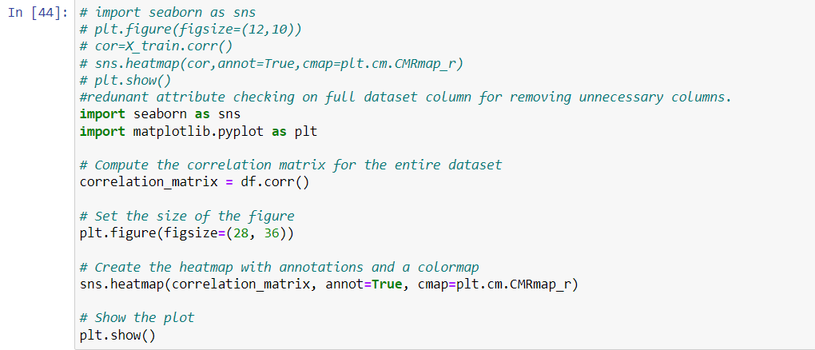
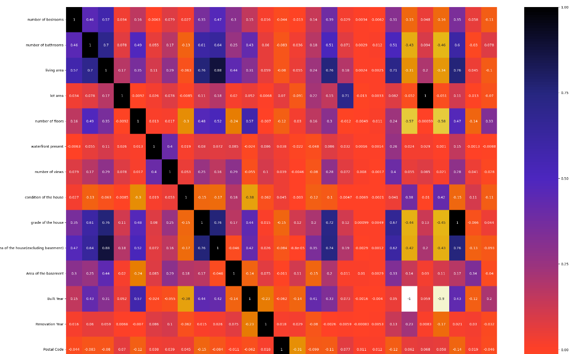
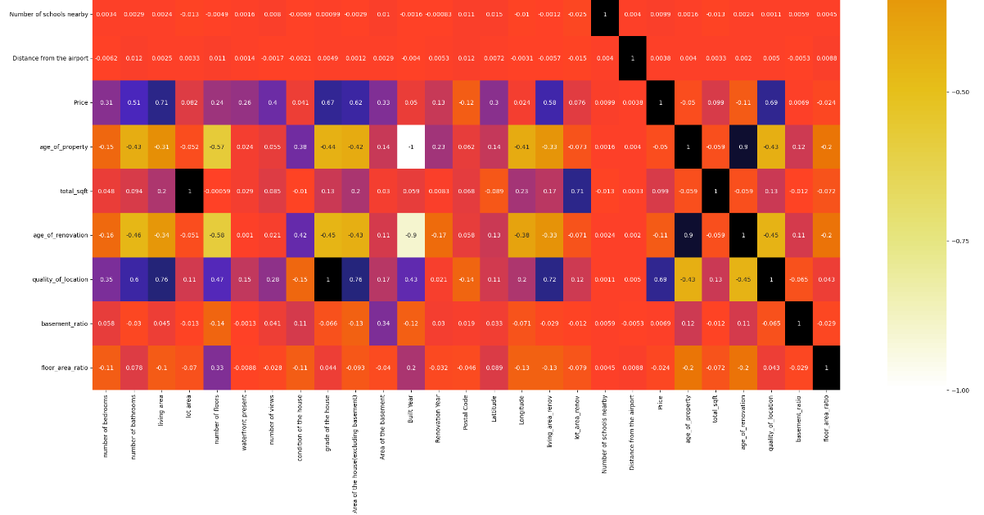

Slide 49
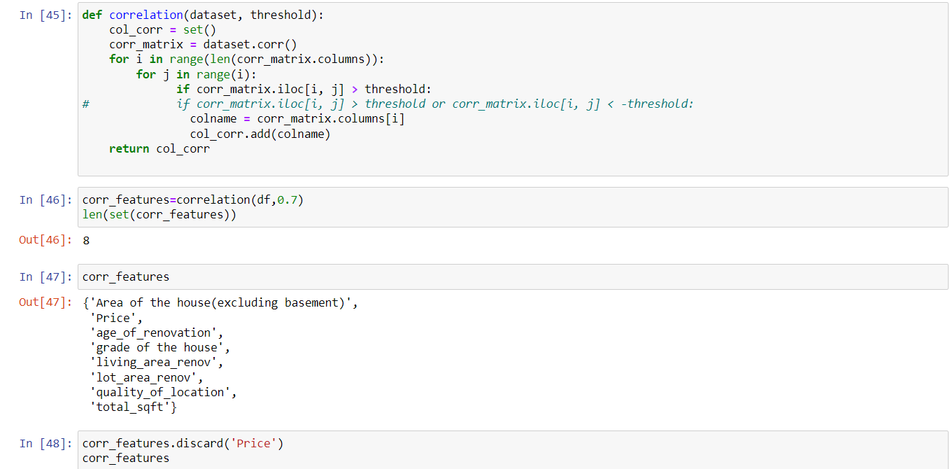
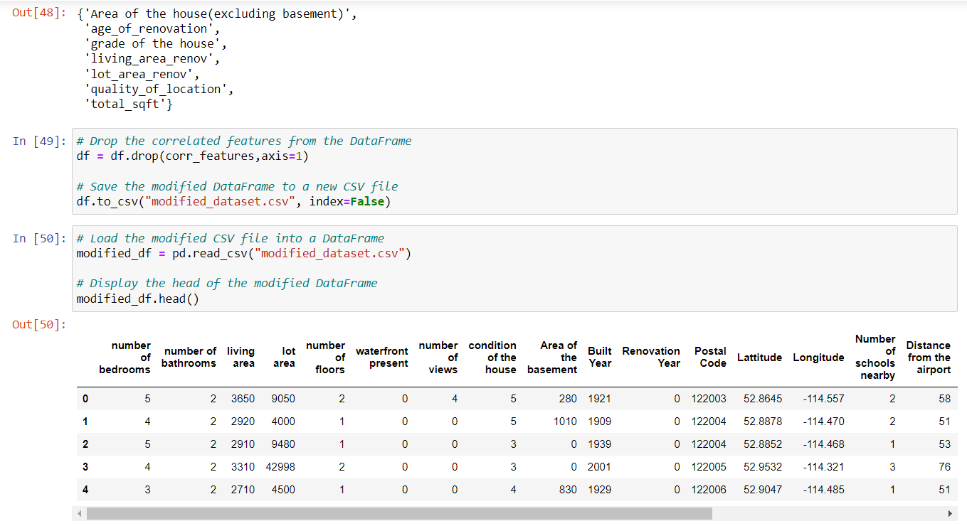

Slide 50
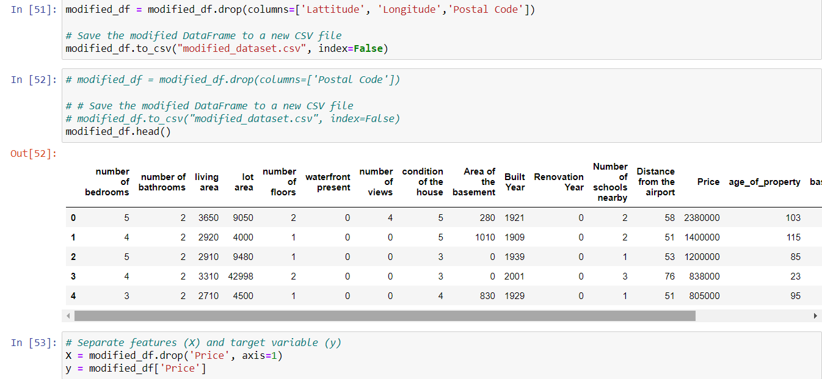
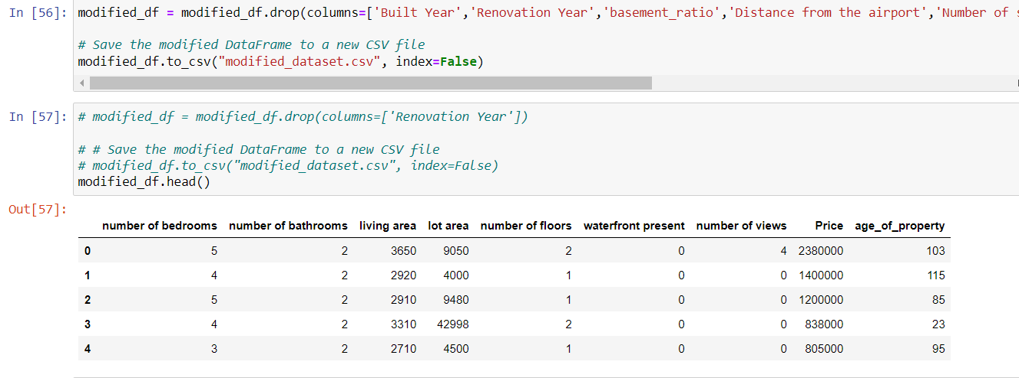

Slide 51



Slide 52



Slide 53



Slide 54



Slide 55


Slide 56

Summary
The project involved analyzing housing data to predict prices in India. After data preprocessing and exploratory data analysis, redundant features were removed, leaving 8 informative features. Three machine learning models (Random Forest, XGBoost, CatBoost) were trained individually and combined using averaging to create an ensemble model. The best model, a combination of the three, achieved high accuracy. A Flask backend was implemented to serve predictions based on user inputs from a frontend interface.

Slide 57


Thank you
.

